Slide 1



Environmental Taxation and Waste Management for a Circular Economy in Albania
Dr. Klejda GABESHI, Faculty of Economy, University of Tirana, Albania
Prof. Assoc. Dr. Etleva BAJRAMI, Faculty of Economy, University of Tirana, Albania
Prof. Dr. Brikena LEKA, Faculty of Economy, University of Tirana, Albania
International Conference on Economy, Business, Innovation and Technology
“ICEBIT 2025: Building Intelligent Economies with Resilient Innovation and Smart Specialization Strategies"
05-06 – December – 2025
Tirana, Albania

Slide 2
Introduction
Environmental and economic performance are now inseparable in development research. Growth is not only measured by how much it increases, but by the pressure it places on natural resources, emissions, and waste systems.
For emerging economies, sustainability is both an institutional challenge and a new space for innovation and long-term efficiency.
International Conference on Economy, Business, Innovation and Technology “ICEBIT 2025: Building Intelligent Economies with Resilient Innovation and Smart Specialization Strategies"

Slide 3
Introduction
Albania’s economy has grown gradually with moderate industrial activity and high hydropower dependence, leading to stable CO₂ emissions, but uneven performance in municipal waste management.
Environmental taxes are increasingly present as a fiscal tool, yet their role remains primarily policy-driven rather than growth-driven, signaling a transition stage toward circular-economy incentives.
International Conference on Economy, Business, Innovation and Technology “ICEBIT 2025: Building Intelligent Economies with Resilient Innovation and Smart Specialization Strategies"

Slide 4
Methodology
Variables used in the analysis:
GDP growth per capita (%)
Environmental tax revenues (% of GDP)
Growth rate of managed municipal waste (%)
CO₂ emissions per capita (metric tons)
(Source: INSTAT / World Bank / Eurostat compiled by the author)
International Conference on Economy, Business, Innovation and Technology “ICEBIT 2025: Building Intelligent Economies with Resilient Innovation and Smart Specialization Strategies"

Slide 5
Methodology
1) Data collection and organization;
2) Descriptive and correlation analysis;
3) Pairwise Granger causality tests (1 Lag);
4) Estimation of a Vector Autoregressive (VAR) model;
5) Interpretation through lagged effects and dynamic interactions (IRFs).
can guide economic and business practices.
International Conference on Economy, Business, Innovation and Technology “ICEBIT 2025: Building Intelligent Economies with Resilient Innovation and Smart Specialization Strategies"

Slide 6
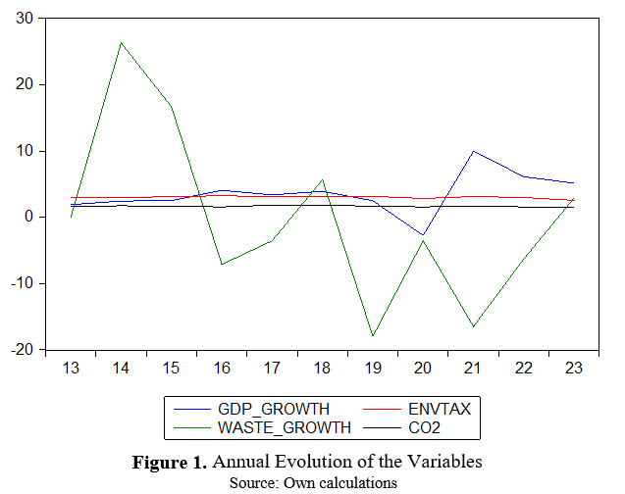
Descriptive Dynamics of the Variables
International Conference on Economy, Business, Innovation and Technology “ICEBIT 2025: Building Intelligent Economies with Resilient Innovation and Smart Specialization Strategies"

Slide 7
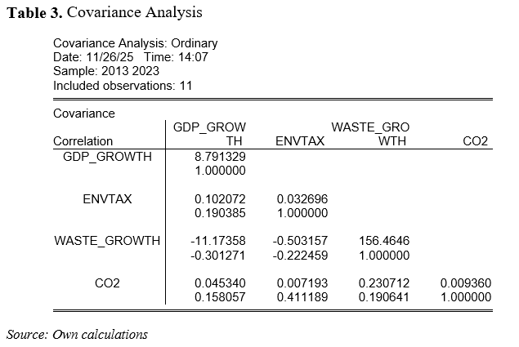
Covariance Analysis
International Conference on Economy, Business, Innovation and Technology “ICEBIT 2025: Building Intelligent Economies with Resilient Innovation and Smart Specialization Strategies"

Slide 8
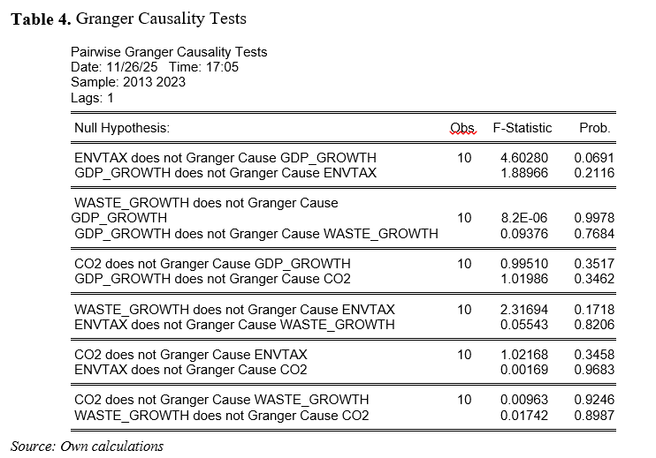
Granger Causality Tests
International Conference on Economy, Business, Innovation and Technology “ICEBIT 2025: Building Intelligent Economies with Resilient Innovation and Smart Specialization Strategies"

Slide 9
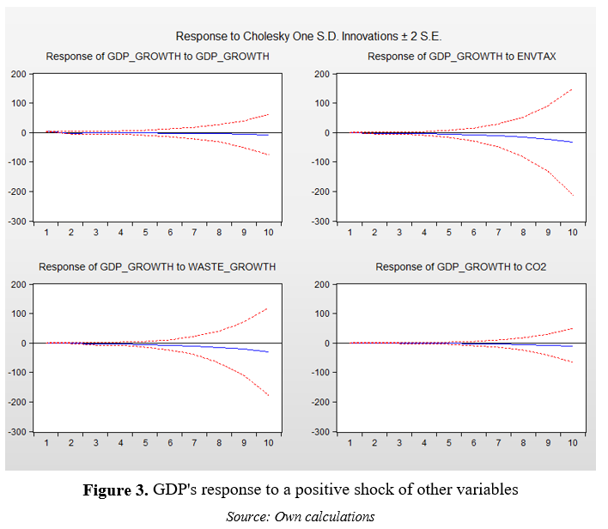
IRFs Results
International Conference on Economy, Business, Innovation and Technology “ICEBIT 2025: Building Intelligent Economies with Resilient Innovation and Smart Specialization Strategies"

Slide 10
Key Insights from Impulse Response Functions
Albania’s GDP growth dynamics appear more responsive to fiscal environmental instruments than to annual emissions or waste fluctuations.
Waste shows infrastructure irregularity, CO₂ remains stable due to hydropower reliance, and environmental taxes still carry an early-stage fiscal signal, reinforcing the importance of policy alignment if circular-economy targets are to gain macro-growth relevance.
International Conference on Economy, Business, Innovation and Technology “ICEBIT 2025: Building Intelligent Economies with Resilient Innovation and Smart Specialization Strategies"

Slide 11
Key Insights from Impulse Response Functions
Environmental taxes show a weak but visible early effect on GDP, while waste and emissions evolve independently in the short run.
The VAR model is treated as exploratory, interpreted qualitatively due to the small sample, but still useful for understanding adjustment direction and decay, offering insights for Albania’s transition toward a more circular fiscal and environmental incentive system.
International Conference on Economy, Business, Innovation and Technology “ICEBIT 2025: Building Intelligent Economies with Resilient Innovation and Smart Specialization Strategies"

Slide 12
Conclusions
Albania has made steady progress in adopting environmental fiscal instruments and expanding waste-management coverage, yet the macro-level economic effects of these policies remain modest when observed year by year.
The analysis shows that environmental taxes carry a weak short-term signal toward GDP growth, while waste growth and CO₂ emissions remain slow, structurally stable, and weak in short-run influence.
International Conference on Economy, Business, Innovation and Technology “ICEBIT 2025: Building Intelligent Economies with Resilient Innovation and Smart Specialization Strategies"

Slide 13
Conclusions
Albania is still in an early transition stage where environmental taxation exists but is not yet a strong economic growth channel.
A circular economy transition is not only about collecting taxes or managing waste, it is about designing a system where these instruments actively reshape incentives, resource efficiency, and sustainable investment.
Albania has the opportunity to strengthen this alignment in the coming years.
International Conference on Economy, Business, Innovation and Technology “ICEBIT 2025: Building Intelligent Economies with Resilient Innovation and Smart Specialization Strategies"

Slide 14
Recommendations
Strengthen environmental tax design;
Increase consistency in waste-management policies;
Support recycling and waste reduction through public investment;
Integrate environmental goals into economic planning.
International Conference on Economy, Business, Innovation and Technology “ICEBIT 2025: Building Intelligent Economies with Resilient Innovation and Smart Specialization Strategies"

Slide 15

Acknowledgements
This research is carried out within the framework of the Jean Monnet Module Project “Transitioning to Teaching with Incorporated Education for Sustainable Development- ToTin ESD”, funded by the European Union as part of the Erasmus+ programme.
International Conference on Economy, Business, Innovation and Technology “ICEBIT 2025: Building Intelligent Economies with Resilient Innovation and Smart Specialization Strategies"

